Slide 1
Work Shop Outline
Gravimetric Geoid Development
60 minute presentation
30 minute break and Q&A period
Hybrid Geoid Development
60 minute presentation
30 minute break and Q&A period
Summary and Outlook
30 minute presentation
30 minute break and Q&A period

Slide 2
Summary and Outlook
Significant changes from GEOID03 to GEOID09
Example: Arizona
Better fit to the data currently in the NGSIDB
Future improvements: near- and far-term
Why make a new vertical datum?
Accuracy versus Precision
Better ties to MSL
Better ties between all regions (HI to VI)

Slide 3
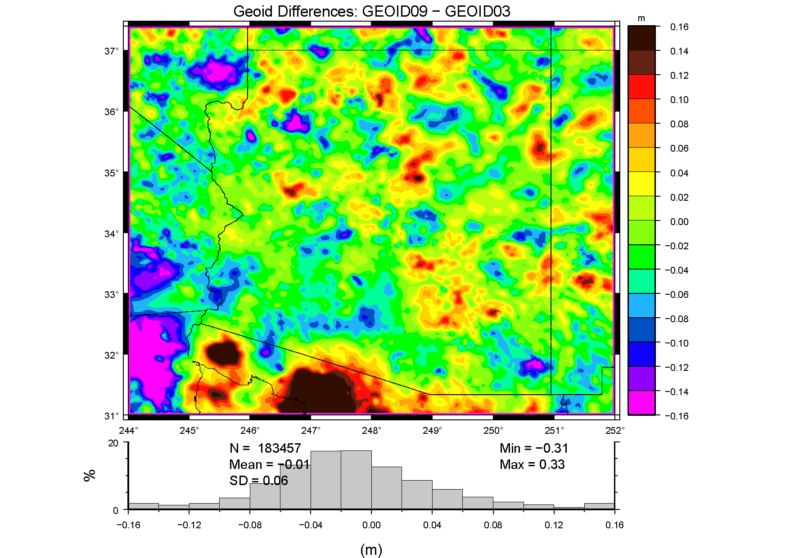
Arizona: An Example or, As Dave Minkel said, “… should I really expect to see a 5 decimeter range of difference from the previous NAD83 realization and/or Geoid03?”
Notes:
Arizona makes a good example of the differences because it has limited spot gravity and GPSBM coverage.
So what caused these differences?
Examination will be to deconstruct how the models were made and the impact of individual changes.

Slide 4
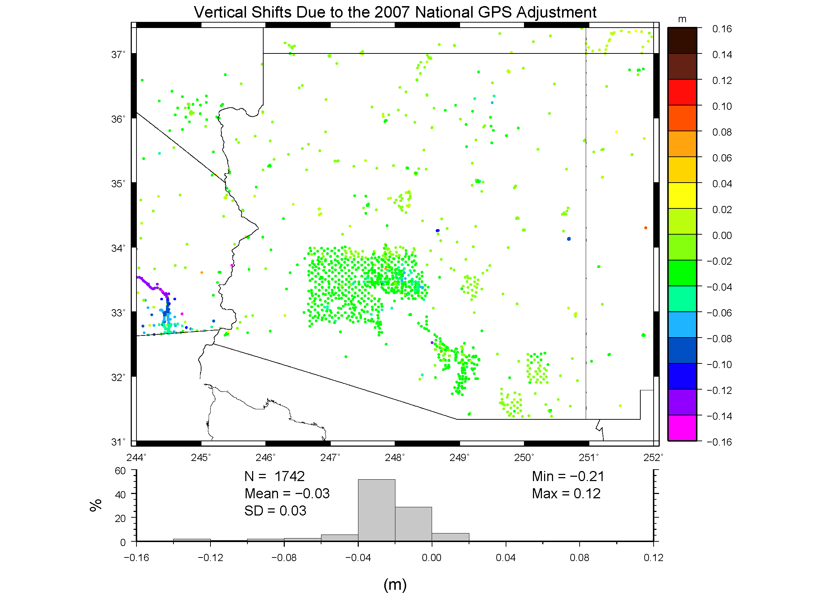
NRA2007 differences
Notes:
Hmm, it’s not the change in the ellipsoid height from the NRA2007.
Since the leveled heights haven’t changed that much (and there are far fewer GPSBM’s than these GPS sites), this probably isn’t the source.

Slide 5
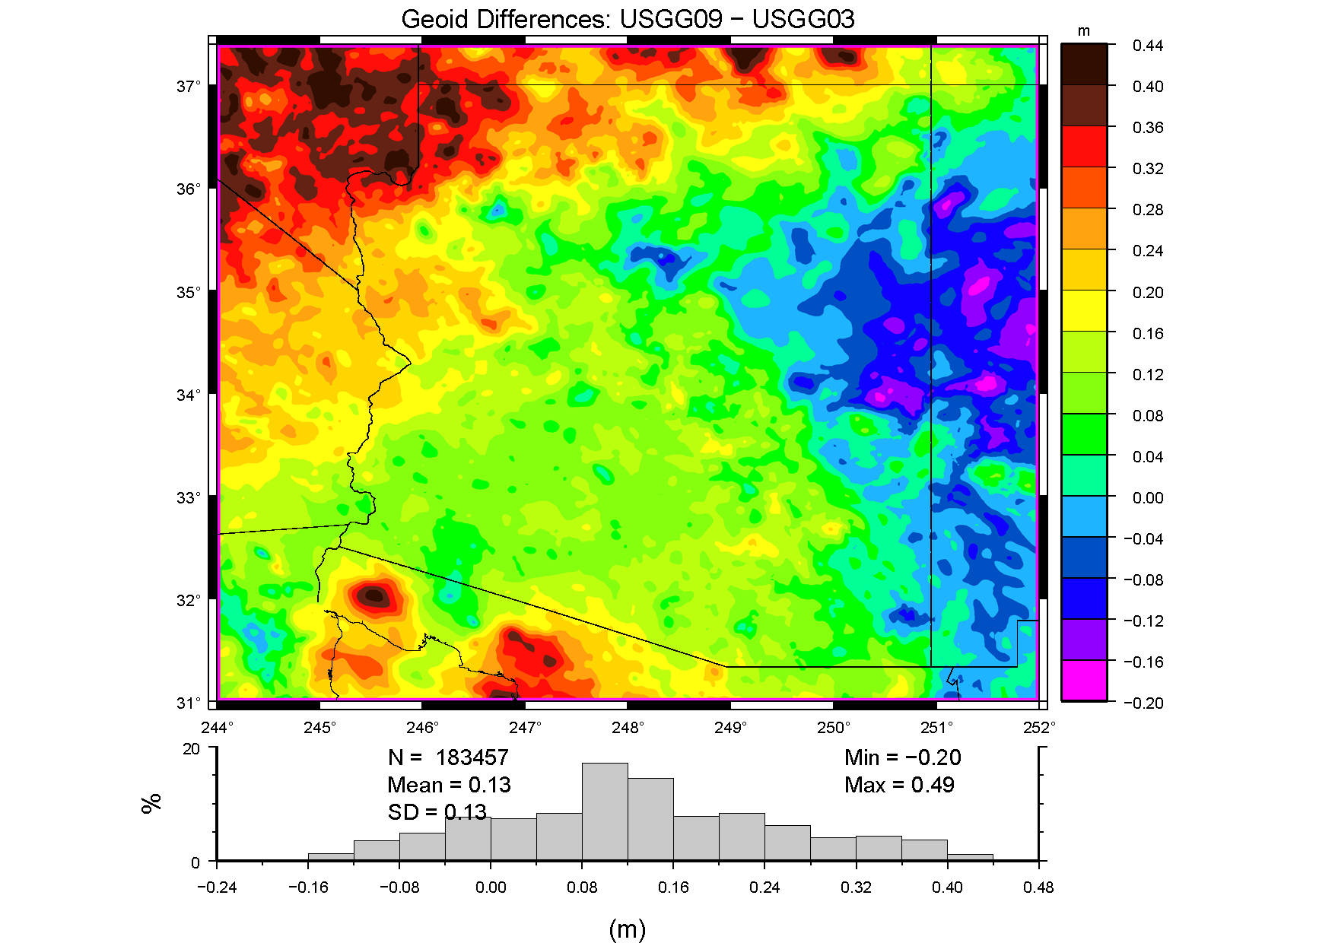
Differences in USGG Models
Notes:
Ah, the major differences seem to derive from the underlying gravimetric geoids.
The big differences there are the gravity data and the reference models.

Slide 6
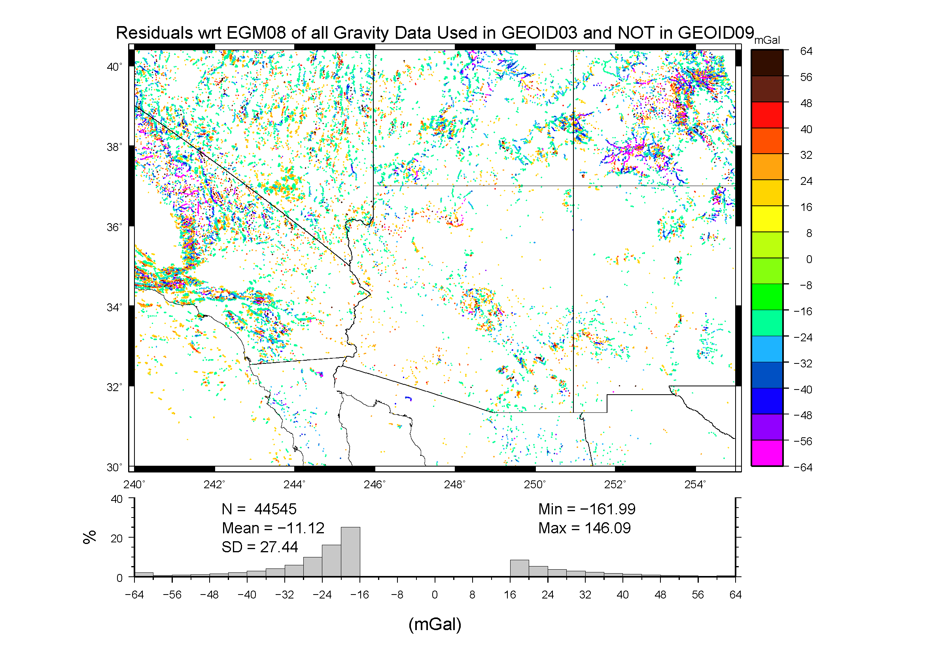
Surface Gravity Rejected in USGG2009
Notes:
There was certainly more poorer quality data used in 2003 than in 2009.
This would account for some of it, but the dropped data is fairly sparse.

Slide 7
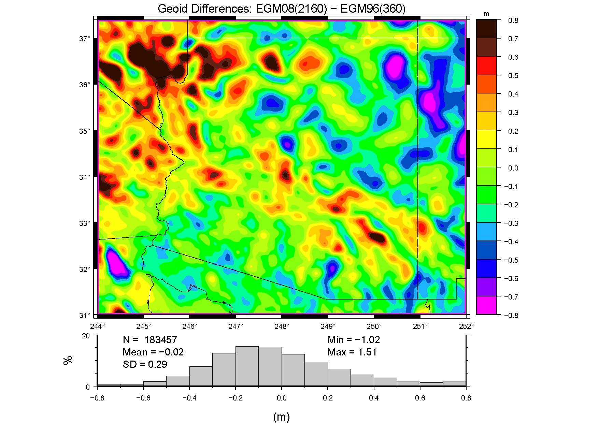
Differences in the Reference Models
Notes:
Here’s the most likely source of the differences.
The surface data will mitigate some of this by filling in shorter wavelengths.
The major difference is that EGM08 was built on GRACE satellite gravity, which is globally consistent and cm-level accurate at the scale shown

Slide 8
GEOID09 – GEOID03 Differences
Mainly due to shift in reference model
EGM96 => EGM08 (GRACE)
Significant change in included surface gravity data that are already thin in the mountains
Some change from readjusted ellipsoidal hts
Net effect is a 5 dm difference
GEOID09 better reflects the true geophysics and current ellipsoidal & orthometric heights

Slide 9
Future Improvements
Near Term
GOCE data to further solidify reference field
Less reliance on EGM08 and more on GRACE/GOCE satellite only field
GRAV-D to improve surface gravity and fill voids
Refined geoid modeling techniques
Evaluate incorporation of OPUS-DB GPS values for select locations (i.e., supplement sparse coverage)

Slide 10
Future Improvements
Far Term
Continued evaluation of GRAV-D enhanced geoids
Check against TBM’s
Check against unconstrained GPSBM’s
Comparison with other North American countries
Integration of vertical datums for all U.S. states and territories
Replacement of existing vertical datum (NAVD 88)

Slide 11
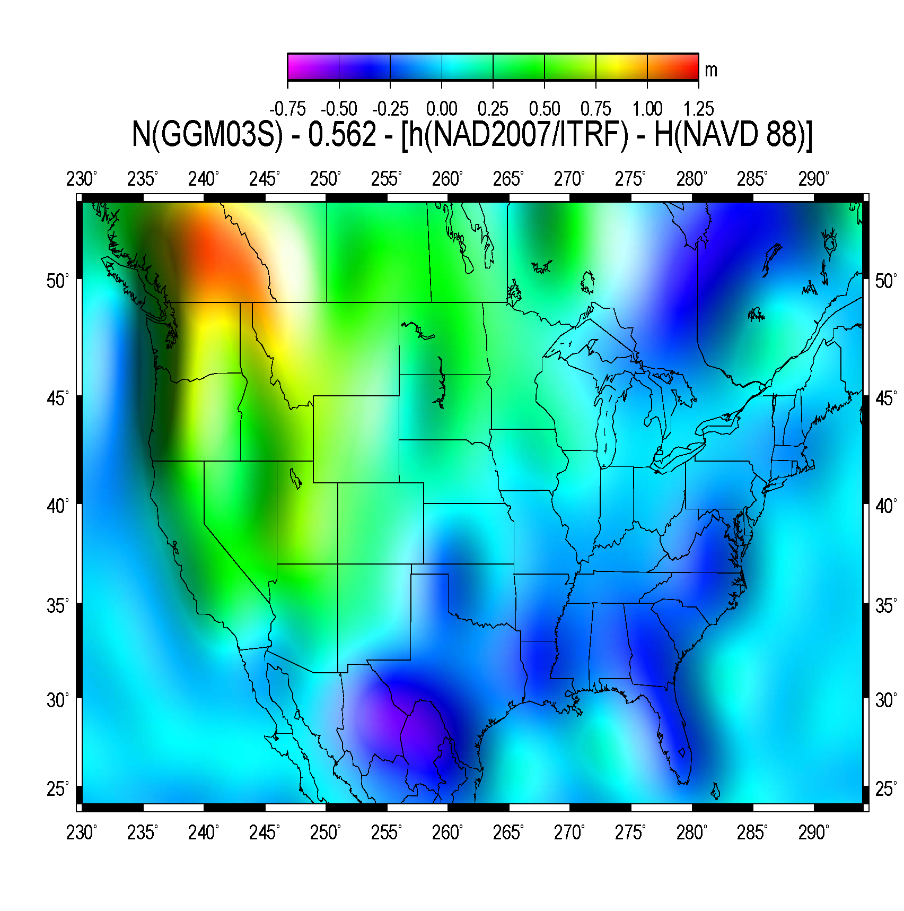
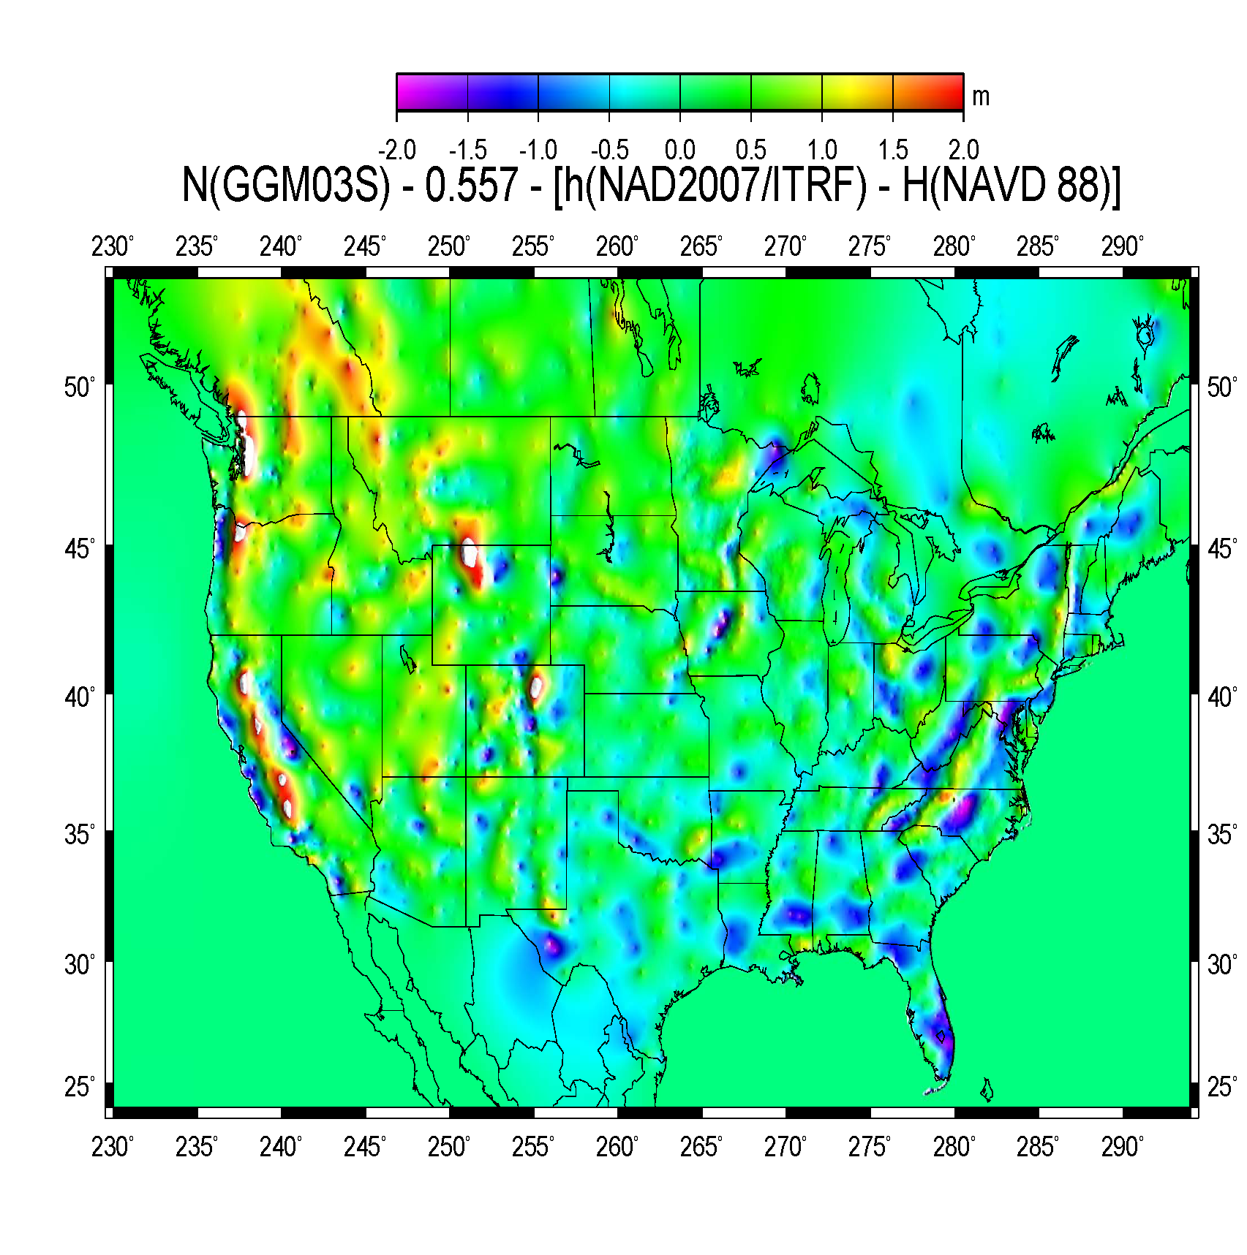
Why make a new vertical datum?
Courtesy of Dr. Dennis Milbert
Notes:
Geez, I just migrated from NFVD 29!

Slide 12
GRAV-D: Gravity for the Redefinition of the American Vertical Datum
Airborne gravity data provide an internally consistent backbone
Satellite-only EGM’s (GRACE/GOCE) provide long
Airborne data are tied to that and yield to 20 km
Spot surface gravity and terrain models yield short
Refined modeling to reduce commission error
One arc-minute resolution already tested as sufficient to capture a cm-level accurate geoid

Slide 13
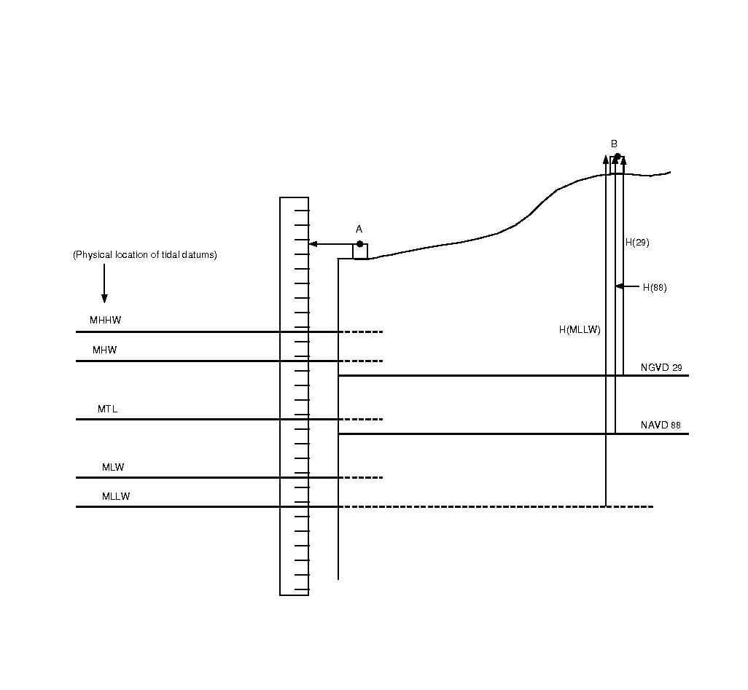
Ellipsoid
H_{BM_0}
- H_{MSL_0}
= ΔH_{BM_MSL}
hBM
N
h_{BM}
- ΔH_{BM_MSL} =
h_{MSL}
- N =
GDOT
BM
Geoid
MSL
0.000
Notes:
A lot of this work is essentially data mining. A wealth of in formation is available from other agencies that needs to be melded into a useful analysis.
Tide gage information provides a lot of information on the behavior of the local sea surface around the country.
The focus here is on CONUS but this work is being expanded to other regions (e.g., Alaska)
The tide gage information can easily be used to find the separation between MSL and the tidal bench mark
The limiting factor is actually obtaining GPS coordinates on the TBM to get local MSL into the ellipsoidal reference frame.
Applying a geoid model then estimates the Dynamic Ocean Topography based on this geometric arrangement (GDOT)
Questions revolve around how reliable DOT models are in near shore environment
VDatum study areas involve topo/bathy lidar work and extensive bottom modeling to determine tide surfaces. DOT is more locally modeled.

Slide 14
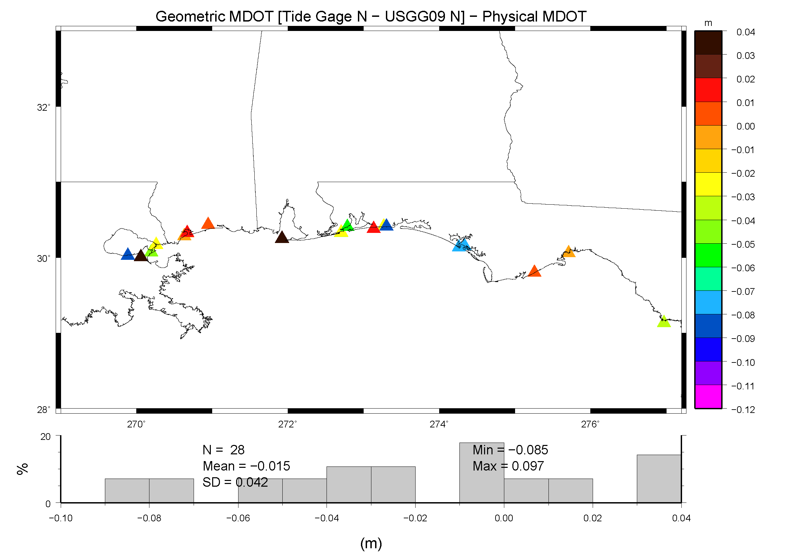
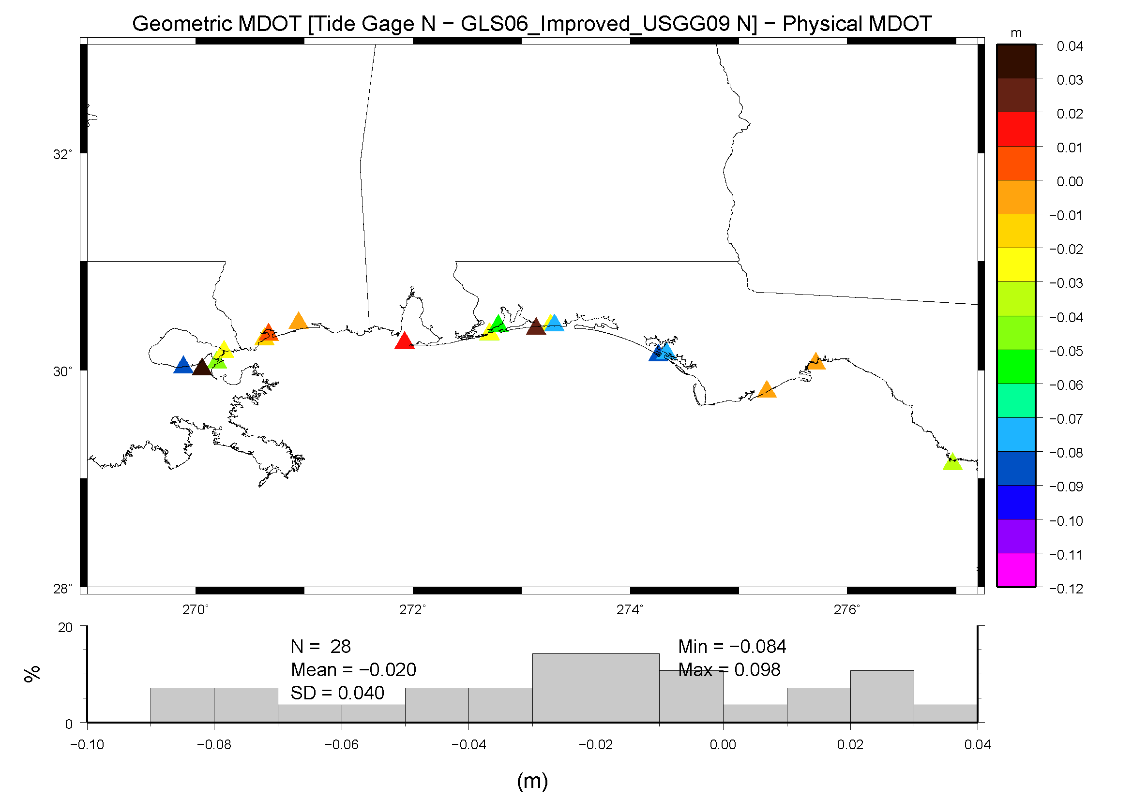
Notes:
Here, the same region is shown now using USGG2009. There is a marked improvement in both the bias and SD.
Addition of airborne data didn’t drastically improve the region, but then these data already compared closely with GRACE data and EGM08 in testing
With USGG2009 being based on EGM08, the difference between a model with and without airborne is limited but still shows some improvement.
Specifically, note that the values at the edges of the GLS06 survey are darker reds or blues. These fade to lighter colors when the aerogravity data are included. This indicates a reduction of residuals. Some stations due show some degradation.
However, this comparison is only along the shoreline – nothing can be seen of any improvements in the near shore region where terrestrial data are lacking.

Slide 15
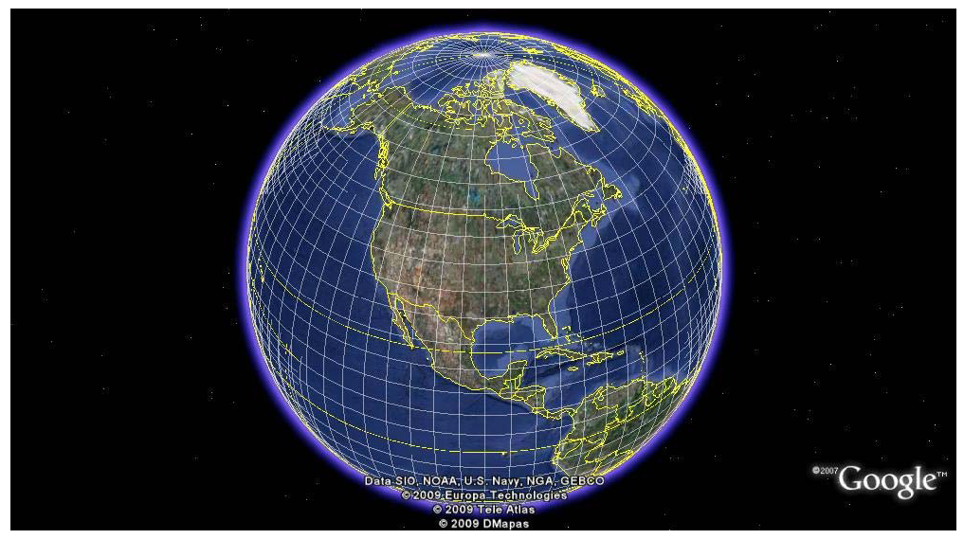
A North American Geoid
Notes:
Sufficient and accurate for all U.S. needs
Transnational for science, engineering, and emergency preparedness applications
Globally consistent

Slide 16
Geoid Research Team
Daniel R. Roman, Ph.D., NGS, GRD
Dan.Roman@noaa.gov, 301-713-3202 x161
Yan Min Wang, Ph.D., NGS, GRD
Jarir Saleh, ERT
Xiaopeng Li, Ph.D., ERT
William Waickman, NGS, SDD
http://www.ngs.noaa.gov/GEOID/

